Slide 1

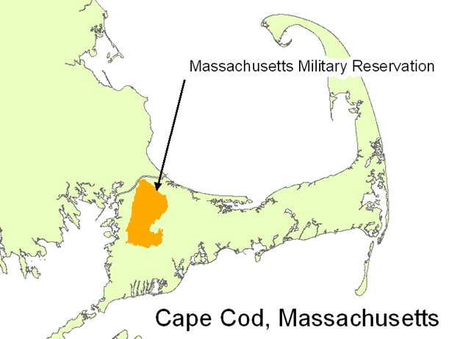
Project Vigilance Value of Ambri Batteries at Joint Base Cape Cod
Paul Hibbard
June 27, 2014

Slide 2
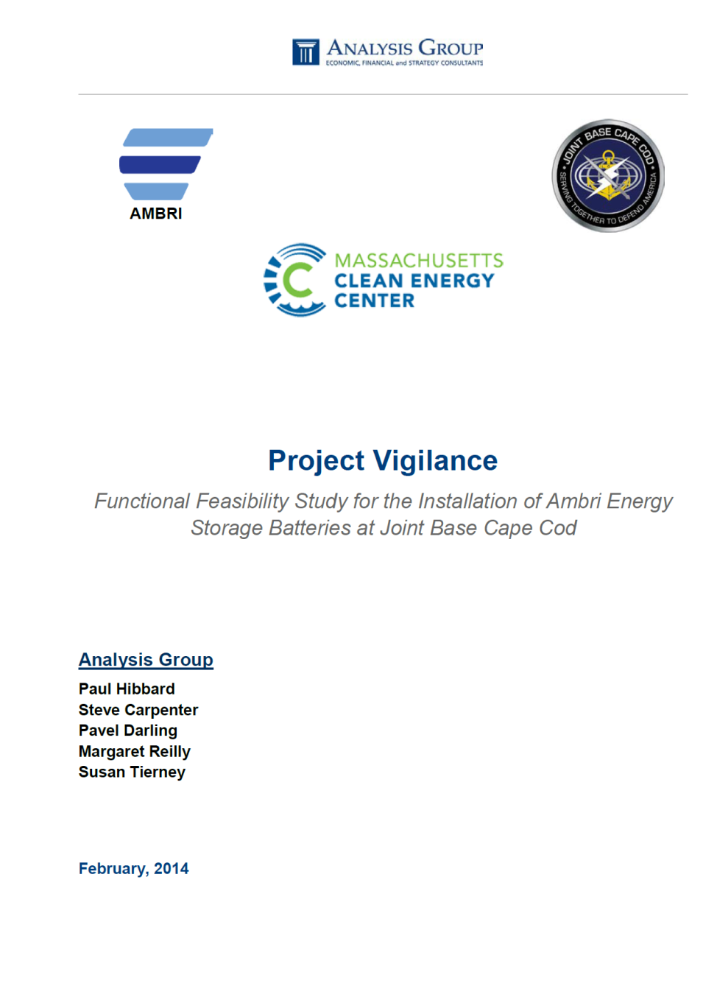
STUDY
Functional Feasibility Study
Funded through the InnovateMass Program of the MA Clean Energy Center
Part of a Demonstration Pilot Project to support the development and deployment of energy storage in the Commonwealth
FFS involves assessing the potential value of energy storage installations paired with substantial renewable generation output
Subsequent stages: deployment of Ambri liquid metal battery systems at JBCC, other MA sites
Partners
MA Development Finance Agency
Ambri Inc.
Joint Base Cape Cod
Raytheon
Analysis Group

Slide 3
Functional Feasibility Study Questions
• Can Ambri’s LMB storage technology benefit the Commonwealth’s energy and environmental policy goals?
• Can installation of Ambri batteries at JBCC generate meaningful cost savings for JBCC as a retail end-use customer, and what factors affect this outcome?
• Can Ambri’s storage support more economic integration of current and/or expanded installations of renewable generation (primarily wind and solar) at JBCC (and in similar settings)?
• Can Ambri batteries enhance the resilience of power supply for JBCC’s critical mission activities if separated from the surrounding power grid? What combinations of generation and Ambri batteries would maximize resilience of critical mission activities in the most economical fashion?
• What is the value of Ambri batteries – alone or in combination with traditional and/or renewable generating assets – in regional wholesale electricity markets?

Slide 4



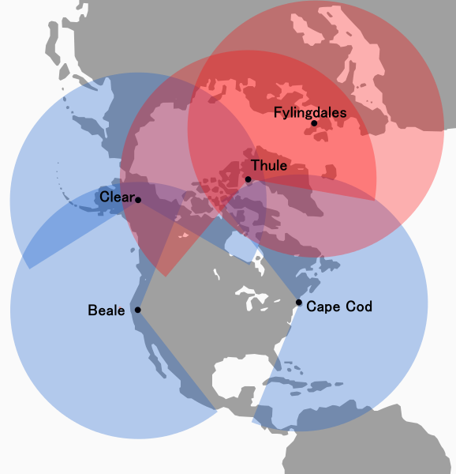

Joint Base Cape Cod (JBCC)
Large Producer/Consumer
26 GWh load (50,000 homes)
4.5 MW avg, 6 MW peak load
$4 million electric bill
(Soon) over 10 MW supply/backup 7.5 MW wind, 6 MW solar, diesel
Critical Missions
Coast Guard
Army National Guard
Air Force communications, intelligence, PAVE PAWS
State & federal military/civilian opn’s, disaster response, law enforcement, municipal agencies
Cost and Policy Goals
Lower electric costs
Maximize value of generation
Maintain uninterrupted power supply
Enable operations separate from grid
Support grid restoration

Slide 5
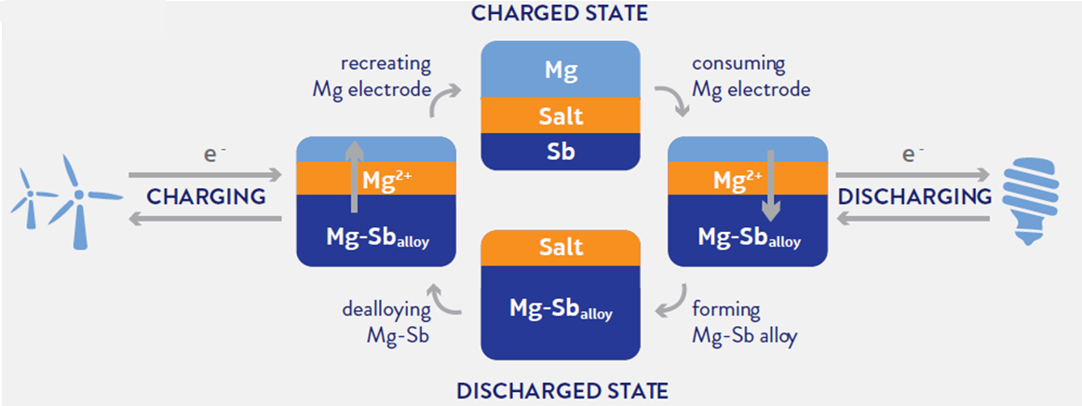
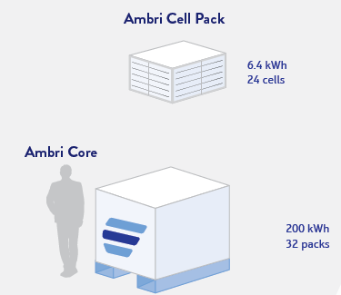
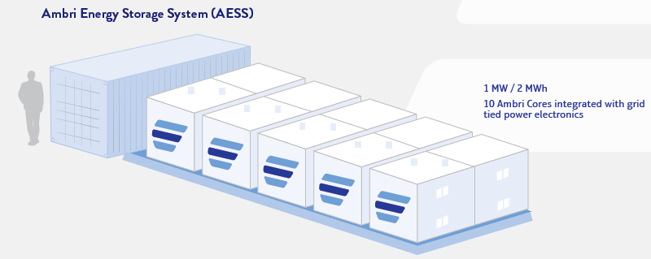
Ambri
Stackable liquid metal battery cells
Systems about size of an 18-wheeler
Can switch between store & discharge instantly
Can operate as capacity/ ancillary service resource
Can be used as energy storage (optimize value of variable output; price arbitrage)

Slide 6
Functional Feasibility Study
Hourly load across the Base
Aggregate hourly demand across multiple agencies
Hourly renewable generation from Base resources
Existing wind, new wind
New solar
Battery charge/discharge “mode”
Storage: fully charge and then let sit? Maintain a minimum level
Cycle: allow swing of full capability based on needs?
Sizing: in consideration of needs and value, how big should the system be?
Value to JBCC
Maintain specific Base “reserves?” Act as a capacity resource?
Buy and sell energy strategically?

Slide 7
Ambri Battery Value Streams
Battery Value | Perspective | Description | Model Approach
Retail Costs | End-use customer | Battery used to minimize all-in cost of electricity | Apply constrained optimization on battery use to minimize customer monthly bills
Critical Load; Resilience & Independence | End-use customer | Battery used to protect critical end-use operations against transmission or distribution outages, or minimize use of back-up generation | Iterative application of battery optimization to minimize hours with net positive critical load
Energy Market Arbitrage | End-use customer or wholesale market participant | Available battery storage capability used to maximize the daily/weekly value of generation in energy market | Apply constrained optimization on battery use to maximize energy market revenues (and/or minimize wholesale energy costs) considering base generation resources and load
Capacity Market Revenues | End-use customer or wholesale market participant | Battery used in power/capacity mode to gain revenues in capacity market | Calculate annual capacity market revenues under different market forecasts
Reserve Market Revenues | End-use customer or wholesale market participant | Battery used in power/capacity mode to gain revenues in reserve market | Calculate annual reserve market revenues based on historical reserve market prices
Regulation Market Revenues | End-use customer or wholesale market participant | Battery capability offered as a regulation resource | Calculate annual regulation market revenues based on average historical market prices
Deferral of Infrastructure Investment | Transmission or distribution utility | Strategic placement of battery storage to support local system reliability | Discuss qualitatively
Power System Reliability and Efficiency | Regional power system operator, wholesale customers | Integration of storage to improve the reliability and efficiency of managing power system peak loads, load-following, and reserve requirements | Discuss qualitatively
Integration of Renewable Resources | Public Policy | Facilitate greater use of low/zero carbon resources to meet state or federal policy objectives; reduce need for traditional peaking resources to balance variability | Iterative application of battery optimization to reduced use of backup generation at increasing levels of renewable integration; discuss qualitatively

Slide 8
AG’s Renewable/Storage Optimization Model (RSOM)
Battery Optimization
Inputs
Optimization Criteria
Output
Load
Selectable load source
Hourly profile
Optimal Hourly Battery Usage (Charge / Discharge)
Generation Sources
Selectable generation, expandable; hourly profile
Behind-the-meter
Minimize Retail Charges
Minimize Volumetric Charges
Minimize Demand Charges
Minimize both
Customer Perspectives
End-users
Wholesale Participants
System operators
Utilities
Municipalities/Coops
RSOM
Maximize Wholesale Benefits
Reserve Market
Capacity Market
Regulation Market
Energy Market
Tables and Charts
Daily/monthly/annual values for net load, battery use, and net load with storage
Total customer monthly/ annual/lifetime cost with and without storage
Monthly/five-day charts showing battery use, net load, and net load with storage
Tabular comparisons of key metrics across multiple scenarios
Location
Nodal, zonal, state, utility or regional price streams
Minimize Load (Energy Independence)
Increase Battery Size
Increase Generation
Battery Specifications
MW max output
MWh total storage
Round-Trip Efficiency
Lifetime (years/cycles)

Slide 9
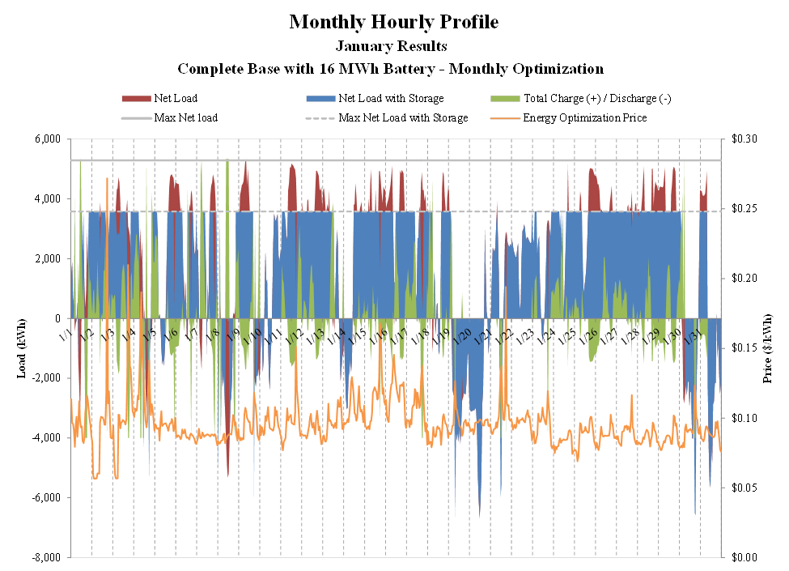
Full base results: 16MWh battery

Slide 10
Full base results: 16MWh battery

Slide 11
Critical Load Analysis
Pave Paws plus rest-of-base critical load; essentially a flat load profile
Testing two questions:
How much more resilient would base be – and how much less back-up fuel would be needed – at different combinations of renewables and storage?
How would batteries/renewables need to be sized to in effect go off-grid completely?
Ultimately, approach would weigh combinations of renewables, storage, back-up generation, and specific resilience objectives
Analysis demonstrates that batteries can be used to significantly increase resilience of operations, and reduce diesel (or other backup) fuel consumption

Slide 12
Critical Load Analysis

Slide 13
Wrap Up
Battery value depends on many factors – optimization objective, prevailing prices (wholesale/retail), surrounding infrastructure, climate (output, load), etc.
Ambri battery flexibility generates meaningful across a wide range of sizes and user objectives
Storage can harden Base operations against local power outages, and at various levels of renewable/storage combinations could dramatically reduce the use of back up fuel for critical mission operations
Storage can facilitate the integration (operationally) of higher amounts of variable renewable generation (as a local distribution issue and/or regional bulk power system issue), and enhance local and regional power system reliability
Meaningful potential for grid defection in certain circumstances through optimal sizing of flexible Ambri storage and BTM renewable capacity

